Slide 1
1998.8.3. Jack & Helen visit my lab. In Taipei

Slide 2
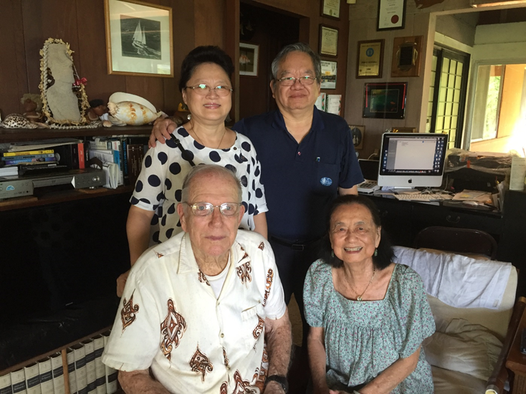
1997.5 12th PSC
2016.6.18 (ICRS13) My wife and I visited his home.

